Slide 2
Cell Membrane Functions
Protects and supports the cell.
Regulates the transport of materials in and out of the cell.

Slide 3
Cell Membrane Structure
Lipid Bilayer: a double layer sheet of phospholipids that makes up the cell membrane.

Slide 4
The Fluid Mosaic Model
The cell membrane is made out of many different parts that freely move.

Slide 5
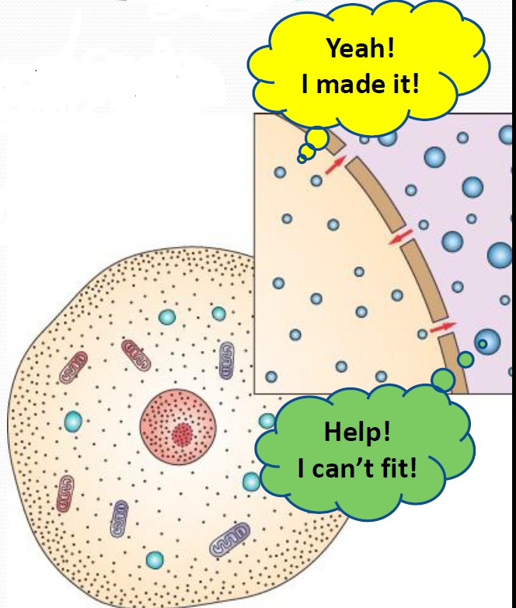
Selectively Permeable
Some substances can pass through the cell membrane
But others can’t.
Permea- means “porous” or “pass through”

Slide 6
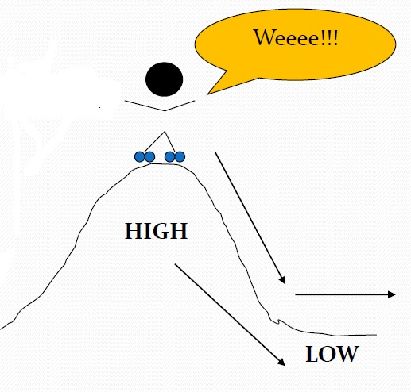
Passive Transport
Movement of substances into/out of cell without using energy.
HIGH→LOW concentration
3 types:
  Simple Diffusion
  Facilitated Diffusion
  Osmosis

Slide 7
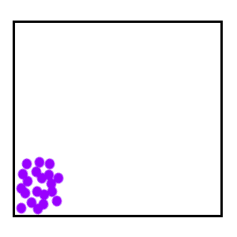
Simple Diffusion
Molecules move from HIGH TO LOW concentration (concentration gradient)
Until balanced or equal- “at equilibrium”

Slide 8
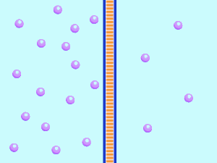

Slide 9
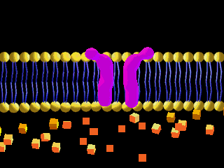
Facilitated Diffusion
Some molecules cant diffuse through the membrane and require special protein channels to move through.
  EX. Ions, Glucose

Slide 10
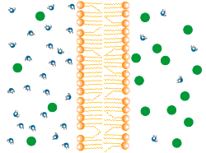
Osmosis
Diffusion of water through special channels called aquaporins.
Moves from high to low concentration.

Slide 14
ISOTONIC

Slide 15
HYPOTONIC

Slide 16
HYPERTONIC

