Slide 1
The Cell Theory
All living things are made up of one or more cells.
All life functions take place in cells, making them the smallest unit of life.
All cells are produced from pre-existing cells through the process of cell division.

Slide 2
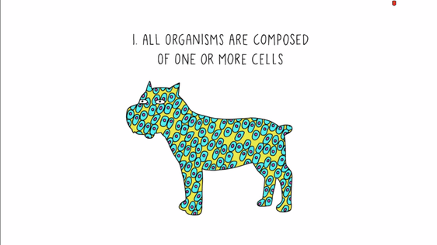

Slide 3
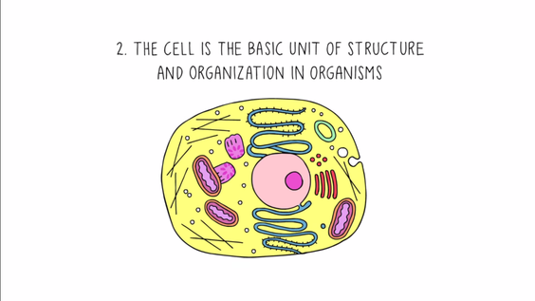

Slide 4
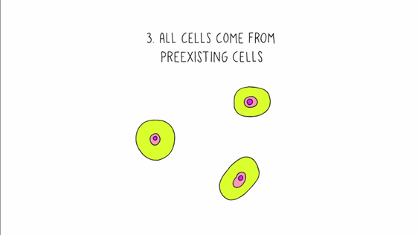

Slide 5
The Chemical Composition of Cell Structures
C, H, O and N are the major elements that make up cells. They combined to create four major organic compounds:
  Lipids (fats)
  Carbohydrates
  Proteins
  Nucleic acids (DNA and RNA)

Slide 6
The Chemical Composition of Cell Structures
Water is the other major compound found in all plant and animal cells. Trace elements found in cells include magnesium, zinc, manganese, and iron.

Slide 7
Cell Membranes
All cells have a selectively permeable cell membrane, which acts as a boundary between the inside and outside of the cell.
The cell membrane is important for keeping substances inside and outside of the cell balanced.

Slide 8
Cellular Transportation
The cell membrane is considered to be selectively permeable (semi-permeable). This means that the cell membrane allows certain particles to pass through it, but some particles cannot pass.

Slide 9
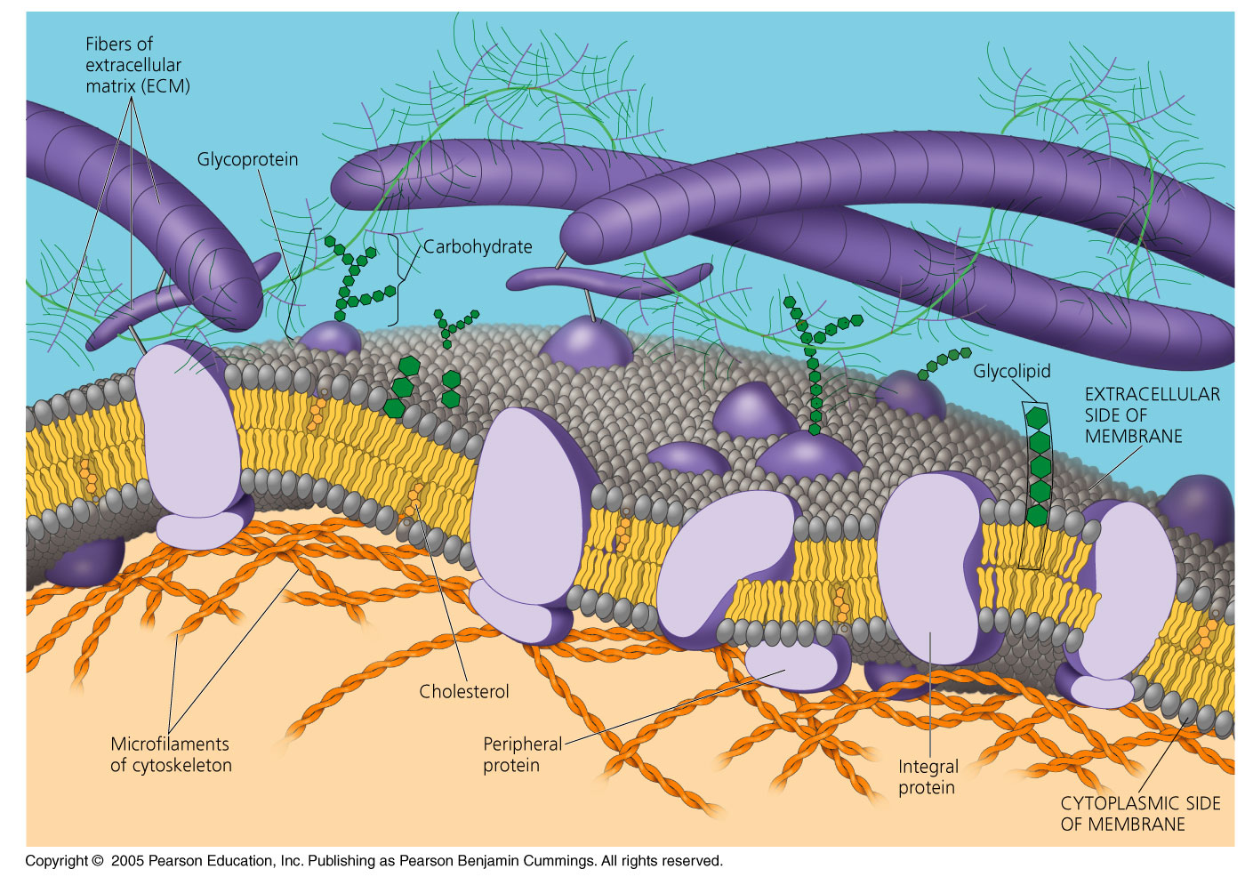
Fluid Mosaic Model of the Cell Membrane

Slide 10
Fluid Mosaic Model of the Cell
The fluid mosaic model of the cell membrane is how scientists describe what the cell membrane looks and functions like, because it is made up of a bunch of different molecules that are distributed across the membrane.

Slide 11
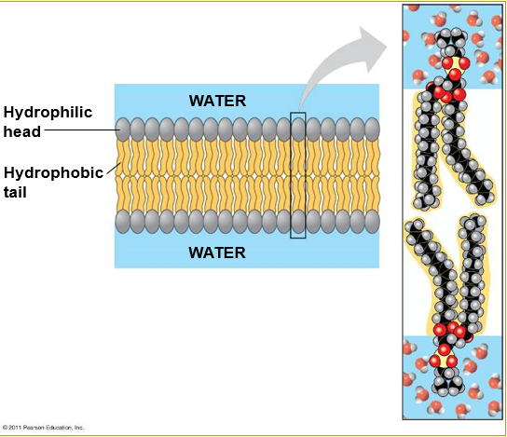
Fluid Mosaic
Model of the
Cell Membrane
A phospholipid bilayer is a double layer of phospholipids that make up the cell membrane.

Slide 12
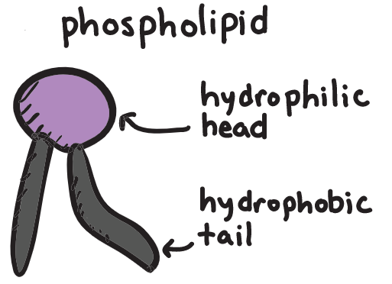
Fluid Mosaic Model of the Cell Membrane
The “head” face out to the watery fluids, because they are hydrophilic.
The “tails” face the inner part of the membrane, because they are hydrophobic.

Slide 13
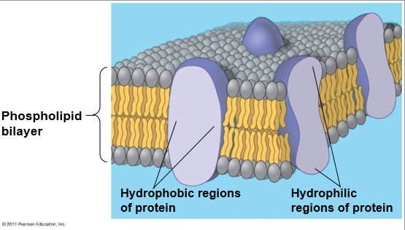

Slide 14
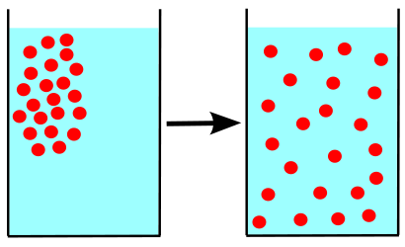
A concentration gradient is the difference between high and low concentrations within a substance.

Slide 15
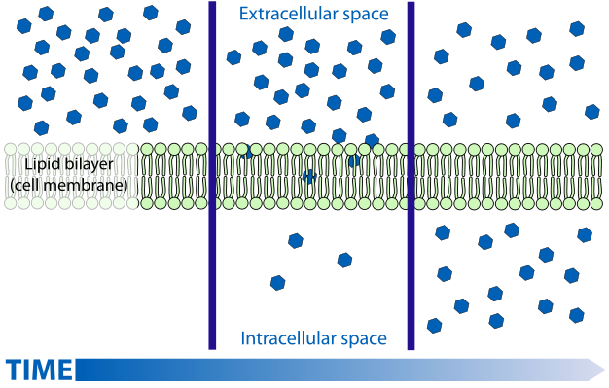
Diffusion is the passive movement of particles from an area of high concentration to an area of low concentration. Particles always diffuse down their concentration gradients (from high to low concentration).
Diffusion is “passive transport” because no added energy is required for it to occur.
http://highered.mcgraw-hill.com/sites/0072495855/student_view0/chapter2/animation__how_diffusion_works.html

Slide 16
Cellular Transportation: Diffusion
Can diffuse into cell:
Cannot diffuse into cell:
Small compounds
Liquid soluble molecules
Non-charged molecules, like H₂O, CO₂ , O₂
Ions
Large macromolecules

Slide 17
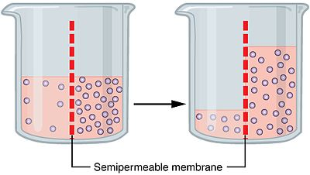
Cellular Transportation: Osmosis
Osmosis is the passive diffusion of water down their concentration gradient, from an area of HIGH water concentration to LOW water concentration.
Osmosis is “passive transport” because no added energy is required for it to occur.

Slide 18
Cellular Transportation: Osmosis
A reminder of some terminology:
  solute = the substance that is dissolved (particles)
  solvent = the substance that does the dissolving (usually water)
  http://highered.mcgraw-hill.com/sites/0072495855/student_view0/chapter2/animation__how_osmosis_works.html

Slide 19
How Do We Know Which Direction Water Will Flow?
That depends if the solution is hypertonic, hypotonic or isotonic.

Slide 20
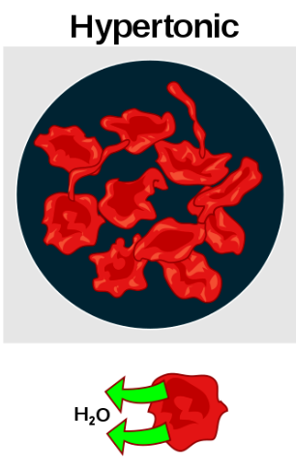
Hypertonic (“hyper” means more than, greater than) The outer solution has more solute particles and less water than inside the cell If the cell is placed into this solution, water will leave the cell, and it will shrivel up

Slide 21
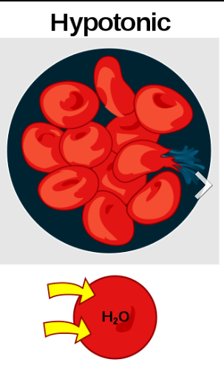
Hypotonic (“hypo” means less than, below) The outer solution has less solute particles and more water compared to that in the cell If the cell is placed into this solution, water will enter the cell, it will swell and burst

Slide 22
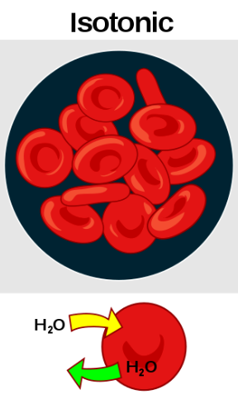
Isotonic (“iso” means equal) The solution has the same concentration of solutes as that in the cell if the cell is placed into this solution, there is no net movement of water molecules.

Slide 23
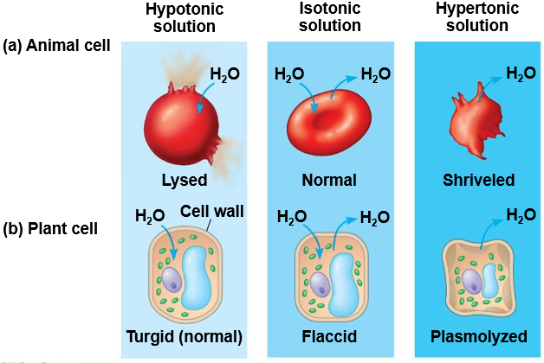

Slide 24
Cell Transportation: Facilitated Diffusion
Some substances cannot move into a cell via diffusion or osmosis.
Facilitated diffusion is passive diffusion using channel proteins or carrier proteins to move particles from an area of HIGH concentration to an area of LOW concentration.
Facilitated diffusion is “passive transport” because no added energy is required for it to occur.

Slide 25
Channel proteins – create pores (channels) for small H₂O-soluble particles to move through.
Carrier proteins – attach to larger molecules that are too big to diffuse – protein changes shape to move molecules across the membrane, then it returns to normal.

Slide 26
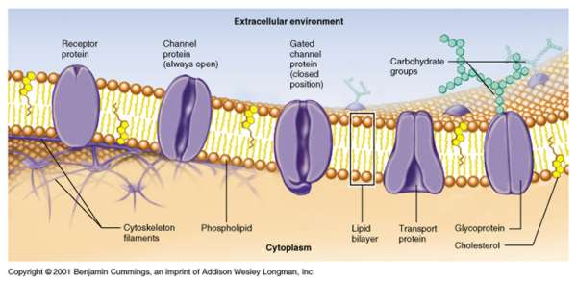
Cell Transportation: Facilitated Diffusion
http://highered.mcgraw-hill.com/sites/0072495855/student_view0/chapter2/animation__how_facilitated_diffusion_works.html

Slide 27
Active Transport, Endocytosis and Exocytosis
Type of Transport | Passive Transport | Active Transport
Concentration Gradient | Works with the concentration gradient HIGH → LOW CONC. | Works against the concentration gradient LOW → HIGH CONC.
Energy | No energy required | Requires energy

Slide 28
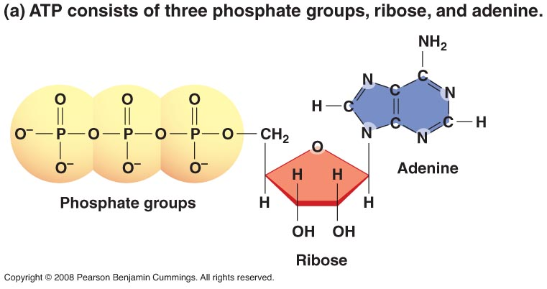
Active Transport, Endocytosis and Exocytosis
The source of energy for active transport is known as ATP – energy that is produced in the mitochondria.
http://www.stolaf.edu/people/giannini/flashanimat/transport/secondary%20active%20transport.swf

Slide 29
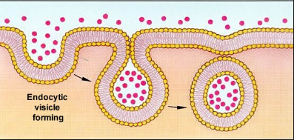
Active Transport, Endocytosis and Exocytosis
Endocytosis
  Actively takes particles INTO the cell by forming a vesicle out of cell membrane – Requires energy

Slide 30
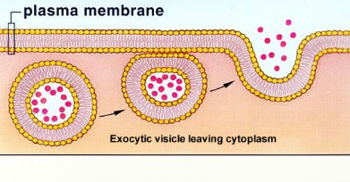
Active Transport, Endocytosis and Exocytosis
Exocytosis
  Actively takes vesicle-bound particles OUT OF the cell by merging the vesicle with the cell membrane – Requires energy
http://highered.mcgraw-hill.com/olc/dl/120068/bio02.swf

Slide 31
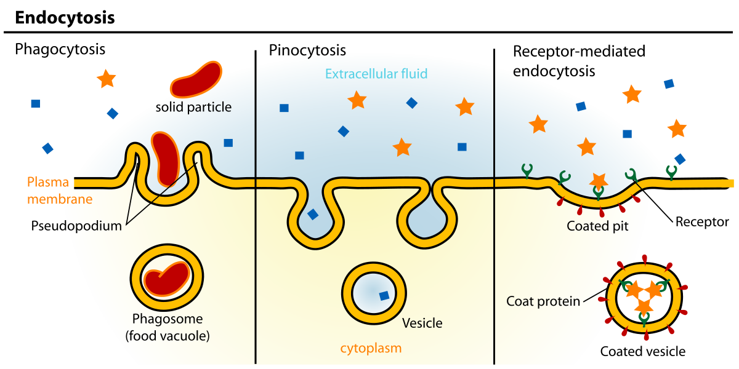
Phagocytosis – “Cell eating” – large particles
Pinocytosis – “Cell drinking” – liquids
Receptor – Mediated Endocytosis

Slide 32
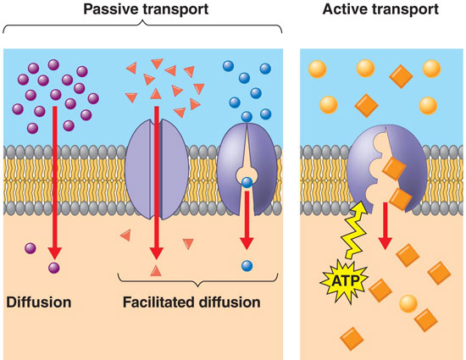
Summary of Cellular Transportation

